Slide 1

Chatbot POV
Jan, 2025

Slide 2
Agenda
Background
Use Cases & Scenario
Solution (Overview, Detailed)
Fitment into IRIS
Conclusion

Slide 3
Background
Ask
    User wants a Chatbot Interface where he can key in Natural Language Questions and the interface can provide the response as needed. Below are the basic requirements.
Basic Requirements
Normal Text to SQL Conversion Case: User Wants to "Get an SQL query to fetch the Last 6 Months of Sales for particular Geography for a particular product“
Fetch Data, Summarized form of Data: a) User wants to fetch and analyze data for a particular period. b) User wants to find a total value for a particular category/criteria
Text to Code Conversion in Python (preferably): User wants to write a code in Python, he don't know the exact syntax, he is looking for help from Chatbot.

Slide 4
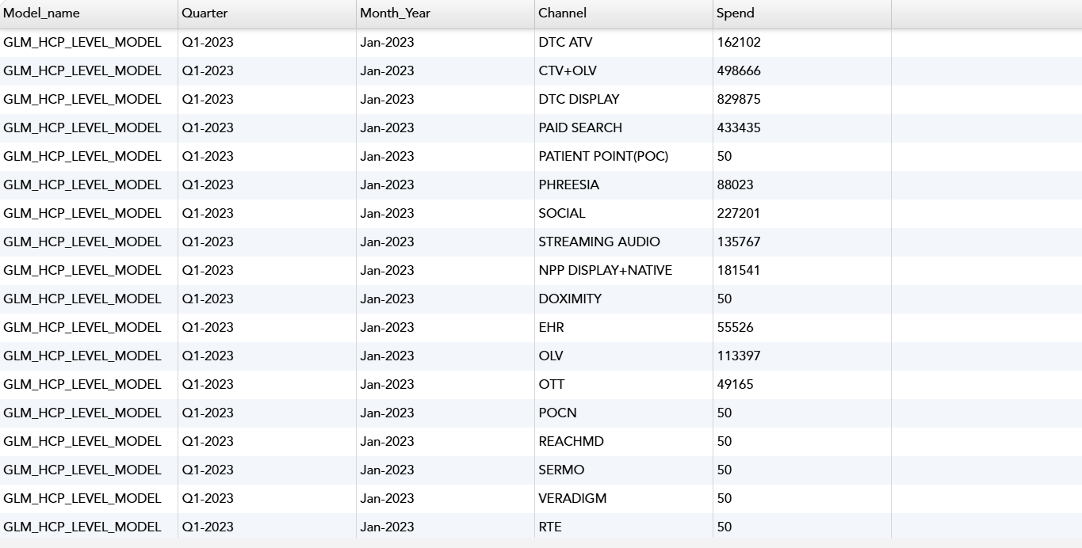
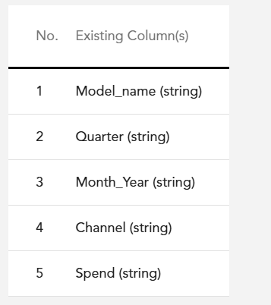
Use Cases
Use Case 1: Text to SQL (Normal Text to SQL Query Conversion)
Considerations: IRIS User (Data Science Team) has the Table “Historical_Spend” which provides the Spend related details for various channels for various months. The below images gives the schema and sample data from that table. This table is present in a particular database “DB1”
Ask: The User wants to get a SQL Query, to retrieve last 6 months of spend from Historical Spend
User I/P: User types in the Chatbot Interface “"Please get me an SQL query to fetch last 6 months of Spend for the Channel “OTT”
Approach:
Chatbot should connect to the Source Database “DB1”
Trace the relevant schema and “Historical_Spend” table and find the exact columns “Spend”, “Month_year”, “Channel” and frame the SQL query (As mentioned below).
Where Condition for filtering the Channel =‘OTT’ and Date function for pulling only the last 6 months data.
Expected O/P:
SELECT Channel, Month_Year, Sum(Spend)
FROM
Historical_Spend
WHERE
Channel = ‘OTT'
AND Month_year >= DATEADD(month, -6, GETDATE())
Currently they are writing the query manually and running in any SQL editor
Table Preview
Schema

Slide 5
Use Cases
Use Case 2: a) Fetch Data, b) Summarize Data
a) Fetch Data
Considerations: IRIS User (Data Science Team) has the Table “Historical_Spend” which provides the Spend related details for various channels for various months. The images below gives the sample data from that table. This table is present in a particular database “DB1”
Ask: The User wants to get a SQL Query, to retrieve/fetch last 6 months of spend from Historical Spend
User I/P: User types in the Chatbot Interface “"Please retrieve the Spend for last 6 months of Spend for the Channel “OTT”
Approach:
Chatbot should connect to the Source Database “DB1”
Trace the relevant schema and “Historical_Spend” table and find the exact columns “Spend”, “Month_year”, “Channel”
Fetch the Spend Amount from the Column “Spend”, for the last 6 months (Month should be referred from the Column “Month_year”), for the respective channel “OTT” (Channel should be referred from the column “Channel”) mentioned in the User I/P
Expected O/P (This is sample data only) :
Currently they are writing the query manually and running in any SQL editor
Table Preview
Schema
Channel | Month | Spend
OTT | Aug, 2024 | 8350
OTT | Sep, 2024 | 9500
OTT | Oct, 2024 | 10000
OTT | Nov, 2024 | 11350
OTT | Dec, 2024 | 24560
OTT | Jan, 2025 | 28960

Slide 6
Use Cases
Use Case 2: a) Fetch Data, b) Summarize Data
b) Summarize Data
Considerations: IRIS User (Data Science Team) has the Table “Historical_Spend” which provides the Spend related details for various channels for various months. The images gives the sample data from that table. This table is present in a particular database “DB1”
Ask: The User wants to retrieve the “Total Spend for the Year 2024 for the Channel ‘OTT’”
User I/P: User types in the Chatbot Interface “"Please get me the Total Spend for the last year for the Channel “OTT”
Approach:
Chatbot should connect to the Source Database “DB1”
Trace the relevant schema and “Historical_Spend” table and find the exact columns “Spend”, “Month_year”, “Channel”
Fetch the Spend Amount (from the Column “Spend”) and Sum up the Spend Amt for all the months in the Year 2024 to derive the “Total Spend”, for the last year 2024 (Year should be referred from the Column “Month_year”), for the respective channel “OTT” (Channel should be referred from the column “Channel”) mentioned in the User I/P
Expected O/P (This is sample data only) :
Currently they are writing the query manually and running in any SQL editor
Schema
Table Preview
Channel | Year | Total Spend
OTT | 2024 | 148350

Slide 7
Use Cases
Use Case 3: Text to Python Code Conversion
Considerations: IRIS User (Data Science Team) has the Table “Historical_Spend” which provides the Spend related details for various channels for various months. The images gives the sample data from that table. This table is present in a particular database “DB1”
Ask: The User wants to get a Python Code, to retrieve last 6 months of spend from Historical Spend for the Channel “OTT”
User I/P: User types in the Chatbot Interface “"Please get me a Python code to retrieve the Spend for last 6 months of Spend for the Channel “OTT”
Approach:
Chatbot should write a Python code to import the required functions, connect to the Source Database “DB1” and the Query to fetch the
For framing the Python, it should trace the relevant schema and “Historical_Spend” table and find the exact columns “Spend”, “Month_year”, “Channel”
Expected O/P (Shown in the next page):
Table Preview
Schema

Slide 8
Use Case 3: Text to Python Code Conversion
Expected O/P:
import sqlite3
from datetime import datetime, timedelta
# Connect to your database
conn = sqlite3.connect('your_database.db')
cursor = conn.cursor()
# Calculate the date 6 months ago
six_months_ago = datetime.now() - timedelta(days=6*30)
# Query to retrieve spend data for the last 6 months
query = """
SELECT date, spend
FROM your_table
WHERE date >= ?
ORDER BY date DESC
"""
# Execute the query
cursor.execute(query, (six_months_ago,))
results = cursor.fetchall()
# Print the results
for row in results:
print(f"Date: {row[0]}, Spend: {row[1]}")
# Close the connection
conn.close()
Notes:
The DB names, Columns names shown are samples only.
The python code should provide the exact DB, table name, column name required

Slide 9



Solution
Solution Overview
Key
Process

Slide 10
Conclusion
Summary
    XYZ
Considerations
    XYZ

Slide 11
Appendix
Use Case 1: Text to SQL (Normal Text to SQL Query Conversion)
Feature | Description | Example
Text to SQL | Normal Text to SQL Conversion | Case: User Wants to "Get an SQL query to fetch the Last 6 Months of Sales for particular Geography for a particular product" I/P: User Types in "Please get me an SQL query to fetch last 6 months of Sales for North America for Amoxycilin" O/P: The Chatbot Should provide "an SQL Query with all the required columns with all the neccessary joins applied on respective tables and with proper Where Clause to filter the Region = "NA" and Product "Amoxycilin"
Trend/Statistics | Collect Data, Evaluate Data, Summarized form of Data - User wants to fetch and analzye data for a particular period or a case | Case: User wants to view the "Last 6 Months Sales for a particular dept under a particular location" I/P: User Types in "Please provide the last 6 months Sales information for Surgicals for North America" O/P: The Chatbot should provide the "Monthly Sales for the last 6 months starting June for the department Surgicals for the region North America"

